Slide 1
Hardware Software Codesign of Embedded System
CPSC689-602
Rabi Mahapatra

Slide 2
Introduction
Digital systems designs consists of hardware components and software programs that execute on the hardware platforms.
K.C: Concurrent and Integrated
Hardware-Software Codesign ?
Mahapatra - Texas A&M - Spring 04

Slide 3
Microelectronics trends
Better device technology
  reduced in device sizes
  more on chip devices > higher density
  higher performances
Mahapatra - Texas A&M - Spring 04

Slide 4
Microelectronics trends
Higher degree of integration
  increased device reliability
  inclusion of complex designs
Mahapatra - Texas A&M - Spring 04

Slide 5
Digital Systems
Judged by its objectives in application domain
Performance
Design and Manufacturing cost
Ease of Programmability
It depends on both the hardware and software components
Mahapatra - Texas A&M - Spring 04

Slide 6
Hardware/Software Codesign
A definition:
Meeting System level objectives by exploiting
the synergism of hardware and software
through their concurrent design
Mahapatra - Texas A&M - Spring 04

Slide 7
Concurrent design
Traditional design flow
Concurrent (codesign) flow
start
start
HW
SW
HW
SW
Designed by independent
groups of experts
Designed by Same group of
experts with cooperation
Mahapatra - Texas A&M - Spring 04

Slide 8
Codesign motivation
Trend toward smaller mask-level geometries leads to:
Higher integration and cost of fabrication.
Amortize hardware design over large volume productions
Suggestion:
Use software as a means of differentiating products based on the same hardware platform.
Mahapatra - Texas A&M - Spring 04

Slide 9
Hardware Programmability
Traditionally
Hardware used to be configured at the time of manufacturing
Software is variant at run time
The Field Programmable Gate Arrays (FPGA)
has blurred this distinction.
Mahapatra - Texas A&M - Spring 04

Slide 10
FPGAs
FPGA circuits can be configured on-the-fly to implement a specific software function with better performance than on microprocessor.
FPGA can be reprogrammed to perform another specific function without changing the underlying hardware.
This flexibility opens new applications of digital circuits.
Mahapatra - Texas A&M - Spring 04

Slide 11
Why codesign?
Reduce time to market
Achieve better design
    Explore alternative designs
    Good design can be found by balancing the HW/SW
To meet strict design constraint
    power, size, timing, and performance trade-offs
    safety and reliability
    system on chip
Mahapatra - Texas A&M - Spring 04

Slide 12
Categorizing Hardware/Software Systems
Application Domain
  Embedded systems
  Instruction Set Architectures
  Reconfigurable Systems
Degree of programmability
  Access to programming
  Levels of programming
Implementation Features
  – Discrete vs. integrated components
  – Fabrication technologies
Mahapatra - Texas A&M - Spring 04

Slide 13
Application Domains
General purpose computing system
    usually self contained and with peripherals
    Information processing systems
Dedicated control system
    part of the whole system, Ex: digital controller in a manufacturing plant
    also, known as embedded systems
Mahapatra - Texas A&M - Spring 04

Slide 14
Level of Programmability
Systems can be programmed at application, instruction and hardware levels
Application Level: Allows users to specify “option of functionality” using special language.
Example: Programming VCR or automated steering control of a ship
Mahapatra - Texas A&M - Spring 04

Slide 15
Level of Programmability
Instruction-level programmability
  Most common ways with ISA processors or DSP
    compilers are used in case of computers
    In case of embedded systems, ISA is NOT visible
Mahapatra - Texas A&M - Spring 04

Slide 16
Level of programmability
Hardware level programmability
⇓
Example: Microprogramming (determine the behavior of control unit by microprogram)
    Emulating another architecture by alternation of μp
    Some DSP implementations too
    Never in RISC or ISA processors
configuring the hardware (after manufacturing) in the desired way.
Mahapatra - Texas A&M - Spring 04

Slide 17
Typical codesign process
System
Description
Modeling
HW/SW
Partitioning
Unified representation
Software
synthesis
Interface
synthesis
Hardware
synthesis
System
integration
Instruction set level
HW/SW evaluation
Mahapatra - Texas A&M - Spring 04

Slide 18
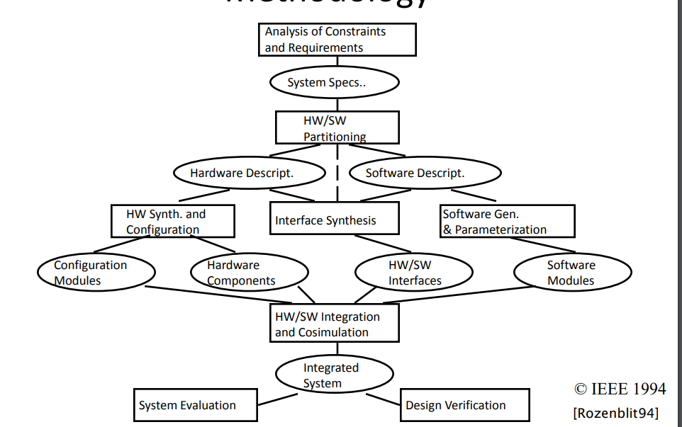
Typical codesign process

